Slide 1
EECS 376
Foundations of Computer Science
Discussion Sec. 20 · Week 5
Name: Samanway (Rick) Sadhu
Email: samanway@umich.edu
OH : Mondays 5–6:30pm (LNW 2421)
Thursdays 2–5pm (LNW 2421)
University of Michigan · Fall 2026

Slide 2

Feedback Form
https://forms.gle/NEsmqjUqPrqnGLWC7
EECS 376 · Discussion 20 · Week 5
46

Slide 3

Worksheet Link
EECS 376 · Discussion 20 · Week 5
2

Slide 4
Formal languages: the basic objects
KEY CONCEPT
A language is just a set of finite strings. The definitions build up in three layers.
1 · Alphabet
2 · String
3 · Language
Σ is a nonempty, finite set of symbols.
Example: Σ = {0,1}
A string over Σ is a finite, ordered sequence of symbols from Σ.
Example: 0101
A language L over Σ is a subset of Σ*.
So L is a set of finite strings over Σ.
Σ* = all finite-length strings over Σ, including the empty string ε.
EECS 376 · Discussion 20 · Week 5
3

Slide 5
From decision problems to languages
KEY CONCEPT
A decision problem asks a YES / NO question. Its language contains exactly the YES instances.
Decision problem
Encode the input
“Given an input object X, does property P hold?”
Write X as a finite string ⟨X⟩ over some finite alphabet Σ.
Language of YES instances
L = { ⟨X⟩ : X has property P }
EECS 376 · Discussion 20 · Week 5
4

Slide 6
Finite automata: formal definition
KEY CONCEPT
A deterministic finite automaton (DFA) is a five-tuple
Definition
M = (Σ, Q, q₀, F, δ)
• Σ: finite input alphabet
• Q: finite set of states
• q₀ ∈ Q: initial state
• F ⊆ Q: accepting states
• δ : Q × Σ → Q: exactly one next state for every state-symbol pair
EECS 376 · Discussion 20 · Week 5
5

Slide 7
How a DFA decides a language
KEY CONCEPT
Run the machine
Accept / reject
Start in q₀. Read the input left-to-right, one symbol at a time, following δ.
After the entire input is consumed: accept exactly when the current state is in F.
Language of the DFA
L(M) = { x ∈ Σ* : M accepts x }
A DFA always halts after exactly |x| transitions — its limitation is finite memory, not running time.
EECS 376 · Discussion 20 · Week 5
6

Slide 8
2.1 Problem 1: decision problem or not?
PROBLEM 2.1.1
Determine whether each is a decision problem. If yes, formulate the corresponding language; if not, change it into a decision problem.
(a)
Given a set of cities, find a set of three cities whose names share at least 3 letters.
(b)
Given a list of classes (start time, end time), is it possible to enroll in at least three classes with no lecture-time overlaps?
EECS 376 · Discussion 20 · Week 5
7

Slide 9
2.1 Problem 1: how do we classify them?
PROBLEM 2.1.1
THINK
Does the problem ask for a YES / NO answer?
If it does, what are the strings that should belong to the language?
EECS 376 · Discussion 20 · Week 5
8

Slide 10
2.1 Problem 1(a): solution
PROBLEM 2.1.1
1
Check the output
“Find a set of three cities” asks us to output an object, not YES / NO.
2
Conclusion
As stated, this is not a decision problem.
3
Convert it
Ask instead: “Given a set of cities, is there a set of three cities whose names share at least 3 letters?”
EECS 376 · Discussion 20 · Week 5
9

Slide 11
2.1 Problem 1(b): solution
PROBLEM 2.1.1
1
Decision form
The answer is YES or NO, so this is a decision problem.
2
Encoding
Encode the class list as an array of integer pairs (s_{c}, e_{c}), using separators between integers and pairs.
3
Language
L = {⟨C⟩ : there exist three classes in C whose lecture intervals are pairwise non-overlapping}.
EECS 376 · Discussion 20 · Week 5
10

Slide 12
2.1 Problem 2: alphabet, encoding, language
PROBLEM 2.1.2
For each decision problem: (i) choose a finite alphabet Σ, (ii) give an encoding ⟨X⟩, and (iii) define the YES-instance language.
(a)
Given a binary string b, does it contain an even number of 0s?
(b)
Does a non-negative integer x, written in base 10, end in the digit 3?
(c)
Does a given C++ program halt on input “eecs376” within 376 steps?
EECS 376 · Discussion 20 · Week 5
11

Slide 13
2.1 Problem 2: build each language
PROBLEM 2.1.2
THINK
For each input type:
1) What symbols are needed to write it? 2) What string represents it? 3) Which encodings should be accepted?
EECS 376 · Discussion 20 · Week 5
12

Slide 14
2.1 Problem 2(a): solution
PROBLEM 2.1.2
1
Alphabet
Σ = {0,1}.
2
Encoding
Encode the binary string directly; for b = “010”, ⟨b⟩ = 010.
3
Language
L = {⟨b⟩ : b is a binary string with an even number of 0s}.
EECS 376 · Discussion 20 · Week 5
13

Slide 15
2.1 Problem 2(b): solution
PROBLEM 2.1.2
1
Alphabet
Σ = {0,1,…,9}.
2
Encoding
Write the integer in ordinary base-10 notation; e.g., ⟨47⟩ = 47.
3
Language
L_{EndWith3} = {⟨k⟩ : k mod 10 = 3}.
EECS 376 · Discussion 20 · Week 5
14

Slide 16
2.1 Problem 2(c): solution
PROBLEM 2.1.2
“Step” can be any fixed reasonable machine-level notion (e.g., TM transitions).
1
Alphabet
Use a finite character set such as ASCII.
2
Encoding
Encode the entire C++ source file as its ASCII character string.
3
Language
L_{HaltEECS376} = {⟨M⟩ : M halts on input “eecs376” within 376 steps}.
EECS 376 · Discussion 20 · Week 5
15

Slide 17
2.2 Problem 3: can a DFA decide this language?
PROBLEM 2.2.3
Question
True or False: there is a DFA that decides
L = { x : x is a binary string of length 4 that starts with two 1s }.
Justify your answer.
EECS 376 · Discussion 20 · Week 5
16

Slide 18
2.2 Problem 3: construction hint
PROBLEM 2.2.3
THINK
The language only requires remembering a bounded amount:
“Did the first two symbols equal 11?” and “How many symbols have I read up to 4?”
EECS 376 · Discussion 20 · Week 5
17

Slide 19
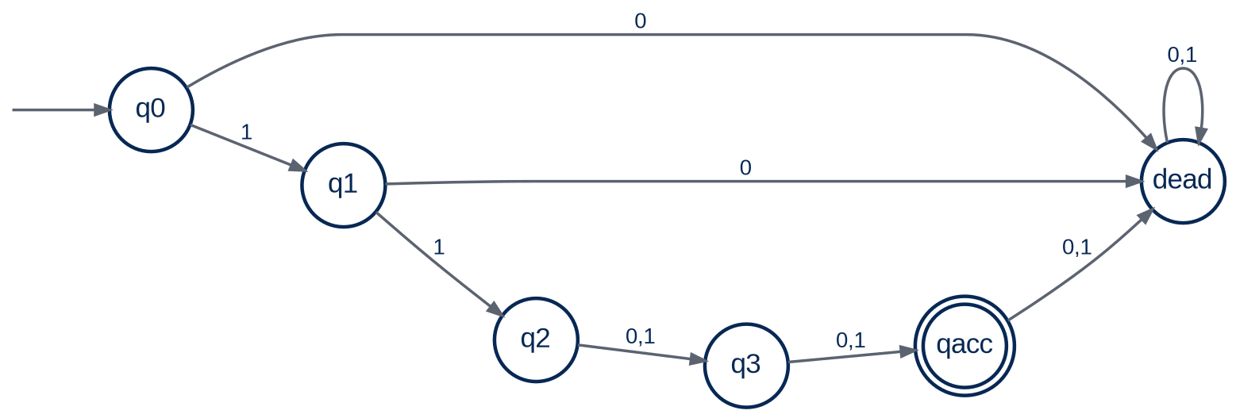
2.2 Problem 3: construct the DFA
PROBLEM 2.2.3
Answer: TRUE. One DFA is:
qdead collects every string that violates the prefix or has length > 4.
EECS 376 · Discussion 20 · Week 5
18

Slide 20
2.2 Problem 3: why it is correct
PROBLEM 2.2.3
1
Length < 4
The machine cannot reach qacc yet, so the string is rejected.
2
Length = 4
Exactly the strings beginning with 11 follow q0→q1→q2 and then two more transitions into qacc.
3
Length > 4
Any extra symbol leaves qacc and enters qdead, so longer strings are rejected.
EECS 376 · Discussion 20 · Week 5
19

Slide 21
2.2 Problem 4: palindromes and finite memory
PROBLEM 2.2.4
Question
True or False: there is a DFA that decides
L = { x : x is a palindrome },
where the alphabet Σ has at least two symbols.
Justify your answer formally.
EECS 376 · Discussion 20 · Week 5
20

Slide 22
2.2 Problem 4: intuition first
PROBLEM 2.2.4
THINK
A palindrome test seems to require remembering an arbitrarily long first half.
Why is “DFA has finite memory” only intuition, not yet a proof?
EECS 376 · Discussion 20 · Week 5
21

Slide 23
2.2 Problem 4: proof plan
PROBLEM 2.2.4
THINK
Assume an arbitrary DFA has s states.
Read s+1 copies of one symbol x and use the pigeonhole principle to force a repeated state.
EECS 376 · Discussion 20 · Week 5
22

Slide 24
Turing Machines
A DFA has finite memory. A Turing machine adds an unbounded tape and a read/write head, giving a general model of computation.
23
EECS 376 · Discussion 20 · Week 5

Slide 25
Turing machine: formal definition
KEY CONCEPT
Definition
M = (Σ, Γ, Q, q_{start}, q_{acc}, q_{rej}, δ)
• Σ: finite input alphabet
• Γ: finite tape alphabet with Σ ⊆ Γ and a blank symbol ⊥ ∉ Σ
• Q: finite state set
• q_{start}: start state; q_{acc} and q_{rej}: distinct halting states
• δ specifies the next state, symbol to write, and head direction
EECS 376 · Discussion 20 · Week 5
24

Slide 26
Turing machine transition function
KEY CONCEPT
Transition rule
δ : (Q \ {q_{acc},q_{rej}}) × Γ → Q × Γ × {L,R}
Read
Write / move
Change state
Current state + symbol under the head
Overwrite that cell, then move one cell Left or Right
Enter the next state; repeat until q_{acc} or q_{rej}
EECS 376 · Discussion 20 · Week 5
25

Slide 27
Running a Turing machine
KEY CONCEPT
On input x, the input symbols occupy the beginning of the tape, the rest is blank, and the head starts on the first symbol.
Outcome 1
Outcome 2
Outcome 3
Eventually enters q_{acc} → ACCEPT
Eventually enters q_{rej} → REJECT
Never reaches a final state → LOOP forever
Unlike a DFA, a Turing machine is not guaranteed to halt.
EECS 376 · Discussion 20 · Week 5
26

Slide 28
Deciding vs. recognizing a language
KEY CONCEPT
Decides L
Recognizes L
Accept every x ∈ L, reject every x ∉ L, and halt on every input.
Accept every x ∈ L; on x ∉ L the machine may reject or loop.
Language of M
L(M) = { x : M accepts x }
A language is decidable if some TM decides it; recognizable if some TM recognizes it.
EECS 376 · Discussion 20 · Week 5
27

Slide 29
Church–Turing Thesis
KEY CONCEPT
Thesis
A function can be computed by an “effective” mechanical procedure (an algorithm) if and only if some Turing machine can compute it.
This is a thesis / modeling principle, not a mathematical theorem.
It is why Turing machines serve as the standard formal model for asking what is computable at all.
EECS 376 · Discussion 20 · Week 5
28

Slide 30
2.3 Problem 1: can one TM decide multiple languages?
PROBLEM 2.3.1
True / False
A Turing machine can potentially decide more than one distinct language.
EECS 376 · Discussion 20 · Week 5
29

Slide 31
2.3 Problem 1: use the definition of L(M)
PROBLEM 2.3.1
THINK
For a fixed machine M, what determines membership in any language it decides?
Can the same accept/reject behavior define two distinct sets?
EECS 376 · Discussion 20 · Week 5
30

Slide 32
2.3 Problem 1: solution
PROBLEM 2.3.1
1
Answer
FALSE.
2
If M decides L
For every x, x ∈ L ⇔ M(x) accepts.
3
Suppose M also decides L′
Then x ∈ L ⇔ M(x) accepts ⇔ x ∈ L′ for every x, so L = L′. A TM either decides exactly one language, or—if it fails to halt somewhere—decides none.
EECS 376 · Discussion 20 · Week 5
31

Slide 33
2.3 Problem 2: many machines, same language
PROBLEM 2.3.2
True / False
For any decidable language L, there is more than one distinct Turing machine M that decides L.
EECS 376 · Discussion 20 · Week 5
32

Slide 34
2.3 Problem 2: change the machine without changing behavior
PROBLEM 2.3.2
THINK
Can you add harmless work before the original machine starts?
Or add states that are never reached?
EECS 376 · Discussion 20 · Week 5
33

Slide 35
2.3 Problem 2: solution
PROBLEM 2.3.2
1
Answer
TRUE.
2
Start with a decider M
Because L is decidable, at least one TM M halts and decides it.
3
Build a different decider M′
Make M′ move one cell right, then one cell left without changing tape contents, and then simulate M exactly. M′ ≠ M but decides the same L.
4
In fact
Vary the harmless prefix or add unreachable states: infinitely many distinct TMs decide L.
EECS 376 · Discussion 20 · Week 5
34

Slide 36
2.3 Problem 3: does every TM recognize a language?
PROBLEM 2.3.3
True / False
Any Turing machine recognizes some language.
EECS 376 · Discussion 20 · Week 5
35

Slide 37
2.3 Problem 3: define the language from the machine
PROBLEM 2.3.3
THINK
Take an arbitrary TM M.
What set do you get by collecting exactly the strings that M accepts?
EECS 376 · Discussion 20 · Week 5
36

Slide 38
2.3 Problem 3: solution
PROBLEM 2.3.3
1
Answer
TRUE.
2
Define L(M)
Let L(M) = {x : M accepts x}. This set may even be empty.
3
Recognition
By construction, x ∈ L(M) iff M accepts x. That is exactly the definition that M recognizes L(M).
EECS 376 · Discussion 20 · Week 5
37

Slide 39
2.3 Problem 4: two tapes vs. three tapes
PROBLEM 2.3.4
True / False
There exists a language X that is the language of some three-tape Turing machine, but is not the language of any two-tape Turing machine.
EECS 376 · Discussion 20 · Week 5
38

Slide 40
2.3 Problem 4: computational power
PROBLEM 2.3.4
THINK
More tapes can make a simulation more convenient or faster, but do they let a TM accept a fundamentally new set of strings?
EECS 376 · Discussion 20 · Week 5
39

Slide 41
2.3 Problem 4: solution
PROBLEM 2.3.4
1
Answer
FALSE.
2
Known equivalence
Finite-tape variants of Turing machines have equivalent computational power: their accept/reject/halt behavior can be simulated by one another.
3
Conclusion
Therefore, every language accepted by a 3-tape TM is also the language of some 2-tape TM, and vice versa.
EECS 376 · Discussion 20 · Week 5
40

Slide 42
2.4 Problem 1: closure under symmetric difference
PROBLEM 2.4.1
Given
Symmetric difference
A and B are decidable languages.
A △ B = (A ∪ B) \ (A ∩ B)
= strings in exactly one of A or B.
Question
A △ B is decidable for (all / some / no) decidable A,B. Justify.
EECS 376 · Discussion 20 · Week 5
41

Slide 43
2.4 Problem 1: combine two deciders
PROBLEM 2.4.1
THINK
Because M_{A} and M_{B} both halt, you can run both on x.
What accept/reject pattern means “x is in exactly one of A and B”?
EECS 376 · Discussion 20 · Week 5
42

Slide 44
2.4 Problem 1: construct a decider
PROBLEM 2.4.1
1
Run both machines
On input x, run M_{A}(x) and M_{B}(x). Since A and B are decidable, both computations halt.
2
Accept condition
Accept iff exactly one of M_{A},M_{B} accepts.
3
Reject condition
Reject if they both accept or they both reject.
4
Conclusion
This machine halts on every x and accepts exactly A △ B, so A △ B is decidable for all decidable A,B.
EECS 376 · Discussion 20 · Week 5
43

Slide 45
2.4 Problem 1: correctness as a truth table
PROBLEM 2.4.1
M_{A}
M_{B}
D
accept
accept
reject
accept
reject
accept
reject
accept
accept
reject
reject
reject
Exactly the two “one accept, one reject” rows belong to A △ B.
EECS 376 · Discussion 20 · Week 5
44

Slide 46

Attendance Form
https://forms.gle/BDiMjBD4jjcvVGd26
EECS 376 · Discussion 20 · Week 5
45

Slide 47
Additional Problems
Same rhythm: one problem slide, a guided hint, then a step-by-step solution. Problem 2.3.5 is moved here as requested.
EECS 376 · Discussion 20 · Computability 1
46

Slide 48
3.1 Problem 1: divisible by 4
ADDITIONAL 3.1.1
Which language represents all positive integers divisible by 4?
• (A) L = { n ∈ Z⁺ : n mod 4 = 0 }
• (B) L = { n,k ∈ Z : n/4 = k }
• (C) L = { n ∈ Z⁺ : gcd(n,4)=1 }
• (D) L = { n,k ∈ Z⁺ : n mod 4 = 2 }
• (E) None of the above
EECS 376 · Discussion 20 · Computability 1
47

Slide 49
3.1 Problem 1: translate the English property
ADDITIONAL 3.1.1
THINK
“Divisible by 4” means the remainder after division by 4 is exactly 0.
Which option states that property for positive integers?
EECS 376 · Discussion 20 · Computability 1
48

Slide 50
3.1 Problem 1: solution
ADDITIONAL 3.1.1
1
Answer
(A).
2
Reason
n mod 4 = 0 is exactly the condition that 4 divides n.
3
Language
L = { n ∈ Z⁺ : n mod 4 = 0 }.
EECS 376 · Discussion 20 · Computability 1
49

Slide 51
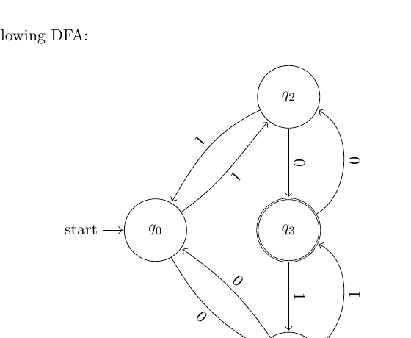
3.2 Problem 1: read a DFA formally
ADDITIONAL 3.2.1
Tasks
(a) State the five components (Q, Σ, δ, q₀, F).
(b) What language does the DFA decide?
Focus on what each state remembers about the prefix read so far.
EECS 376 · Discussion 20 · Computability 1
50

Slide 52
3.2 Problem 1: identify the state invariant
ADDITIONAL 3.2.1
THINK
Each 0 toggles one parity bit; each 1 toggles another.
Which state corresponds to odd #0s AND odd #1s?
EECS 376 · Discussion 20 · Computability 1
51

Slide 53
3.2 Problem 1(a): the five DFA components
ADDITIONAL 3.2.1
Static pieces
Transition function δ
• Q = {q₀,q₁,q₂,q₃}
• Σ = {0,1}
• q₀ is the start state
• F = {q₃}
• q₀: 0→q₁, 1→q₂
• q₁: 0→q₀, 1→q₃
• q₂: 0→q₃, 1→q₀
• q₃: 0→q₂, 1→q₁
EECS 376 · Discussion 20 · Computability 1
52

Slide 54
3.2 Problem 1(b): what language is recognized?
ADDITIONAL 3.2.1
1
Invariant
The state records the parity of the number of 0s and the parity of the number of 1s seen so far.
2
Accepting state
q₃ is reached exactly when both parities are odd.
3
Language
L = { x : x has an odd number of 0s and an odd number of 1s }.
EECS 376 · Discussion 20 · Computability 1
53

Slide 55
3.2 Problem 2: draw a DFA for 1110*
ADDITIONAL 3.2.2
Language
1110* = strings with exactly three leading 1s, followed by zero or more 0s.
Draw a DFA that accepts exactly this language.
EECS 376 · Discussion 20 · Computability 1
54

Slide 56
3.2 Problem 2: build the prefix chain
ADDITIONAL 3.2.2
THINK
Use one state after seeing each required 1.
After the third 1, what should 0 do? Where should every “wrong” symbol go?
EECS 376 · Discussion 20 · Computability 1
55

Slide 57
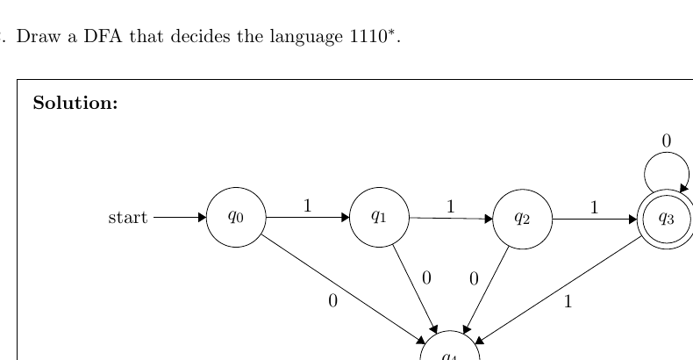
3.2 Problem 2: solution DFA
ADDITIONAL 3.2.2
The accepting state loops on 0; every invalid transition goes to a dead state.
EECS 376 · Discussion 20 · Computability 1
56

Slide 58
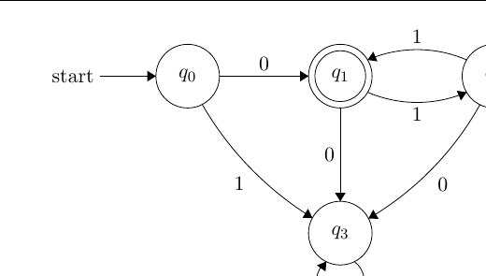
3.2 Problem 3: trace the DFA
ADDITIONAL 3.2.3
(a) Test these strings
ε, 0, 1, 010, 011, 111
(b) Identify the language
Give the language in “string notation” / regular-expression form.
Trace each symbol from the start state and check whether the final state is accepting.
EECS 376 · Discussion 20 · Computability 1
57

Slide 59
3.2 Problem 3: look for a repeating two-symbol pattern
ADDITIONAL 3.2.3
THINK
The only way back to the accepting state after the first 0 is to read 11.
What regular expression starts with 0 and then repeats pairs of 1s?
EECS 376 · Discussion 20 · Computability 1
58

Slide 60
3.2 Problem 3: solution
ADDITIONAL 3.2.3
1
Trace the samples
Accepted: 0 and 011. Rejected: ε, 1, 010, 111.
2
Pattern after the first symbol
The first symbol must be 0. After that, the DFA must read 1s in pairs to return to the accepting state.
3
Language
Regular expression: 0(11)*.
EECS 376 · Discussion 20 · Computability 1
59

Slide 61
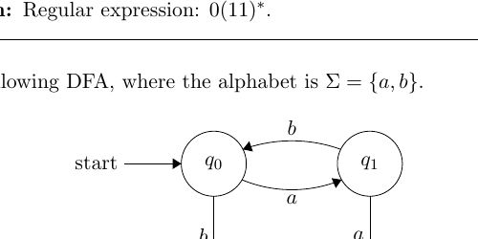
3.2 Problem 4: trace another DFA
ADDITIONAL 3.2.4
(a) Test these strings
ε, a, b, bb, aab, abbabb, ababb
(b) Identify the language
Give the language in string / regular-expression form.
Which short block cycles from q₀ back to q₀ before the final accepting b?
EECS 376 · Discussion 20 · Computability 1
60

Slide 62
3.2 Problem 4: separate the repeated prefix from the final symbol
ADDITIONAL 3.2.4
THINK
From q₀, the pair “ab” returns to q₀.
A single b from q₀ reaches the accepting state. What pattern does that describe?
EECS 376 · Discussion 20 · Computability 1
61

Slide 63
3.2 Problem 4: solution
ADDITIONAL 3.2.4
1
Sample strings
Accepted: b and ababb. The other listed strings are rejected.
2
Repeated block
Every “ab” cycle returns to q₀.
3
Final step
A final b moves q₀ to the accepting state.
4
Language
Regular expression: (ab)*b.
EECS 376 · Discussion 20 · Computability 1
62

Slide 64
3.2 Problem 5: draw a DFA for ab*ab
ADDITIONAL 3.2.5
Language
ab*ab
The string begins with a, then has zero or more b’s, then ends with ab.
Draw a DFA that accepts exactly these strings.
EECS 376 · Discussion 20 · Computability 1
63

Slide 65
3.2 Problem 5: treat the middle b* as a loop
ADDITIONAL 3.2.5
THINK
After the first a, loop on b as long as you like.
What two symbols must then appear to finish the string?
EECS 376 · Discussion 20 · Computability 1
64

Slide 66
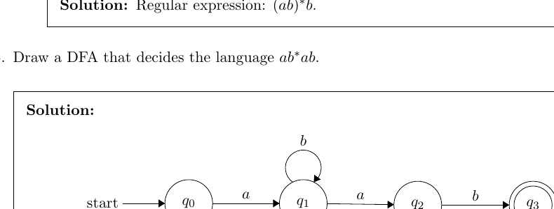
3.2 Problem 5: solution DFA
ADDITIONAL 3.2.5
Any symbol that cannot still lead to the pattern is routed to a dead state.
EECS 376 · Discussion 20 · Computability 1
65

Slide 67
3.2 Problem 6: draw a DFA for ab*(cbc)*aa*
ADDITIONAL 3.2.6
Language
ab*(cbc)*aa*
• one initial a
• then any number of b’s
• then any number of complete cbc blocks
• then one or more a’s
EECS 376 · Discussion 20 · Computability 1
66

Slide 68
3.2 Problem 6: build one region per starred block
ADDITIONAL 3.2.6
THINK
Use a loop for b*. Use a 3-edge cycle for each cbc block.
Then enter a final accepting state for aa* and loop there on a.
EECS 376 · Discussion 20 · Computability 1
67

Slide 69
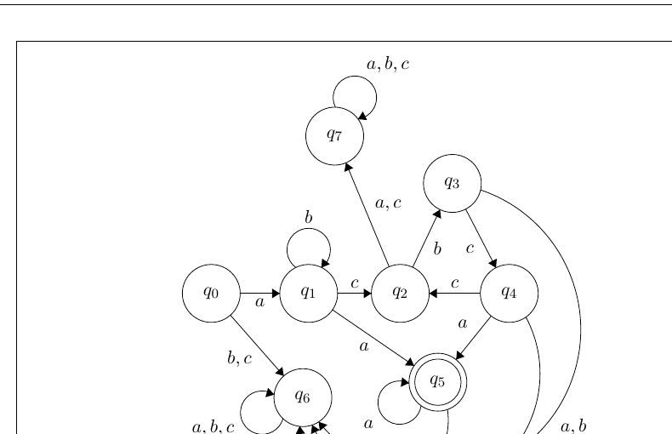
3.2 Problem 6: solution DFA
ADDITIONAL 3.2.6
EECS 376 · Discussion 20 · Computability 1
68

Slide 70
3.2 Problem 7: even number of 0s, last symbol 1
ADDITIONAL 3.2.7
Language
{ x ∈ {0,1}* : x has an even number of 0s and the last character is 1 }
Draw a DFA that tracks both requirements.
EECS 376 · Discussion 20 · Computability 1
69

Slide 71
3.2 Problem 7: track two bits of information
ADDITIONAL 3.2.7
THINK
Bit 1: parity of the number of 0s (even / odd).
Bit 2: whether the most recent symbol is 1.
How many combined states are enough?
EECS 376 · Discussion 20 · Computability 1
70

Slide 72
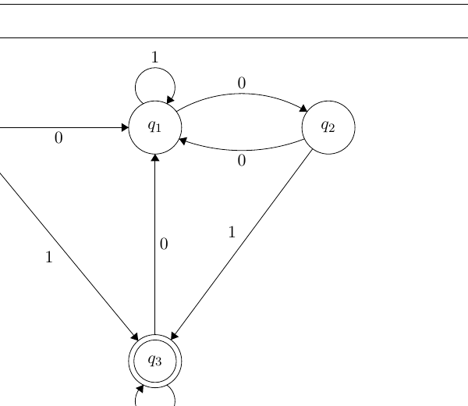
3.2 Problem 7: solution DFA
ADDITIONAL 3.2.7
The accepting state represents: even number of 0s AND latest symbol = 1.
EECS 376 · Discussion 20 · Computability 1
71

Slide 73
3.2 Problem 8: exactly two 0s in every block of 3
ADDITIONAL 3.2.8
Accept binary strings whose length is 3n and every consecutive block of 3 contains exactly two 0s.
Accept
Reject
100010 = 100 | 010
Each block has exactly two 0s.
00100 (wrong length)
110001 (first block has only one 0)
The empty string ε is accepted vacuously.
EECS 376 · Discussion 20 · Computability 1
72

Slide 74
3.2 Problem 8: reset after each 3-symbol block
ADDITIONAL 3.2.8
THINK
Inside the current block, remember two things:
(1) how many symbols of the block have been read; (2) how many of them are 0.
After a valid third symbol, reset to the block-boundary state.
EECS 376 · Discussion 20 · Computability 1
73

Slide 75
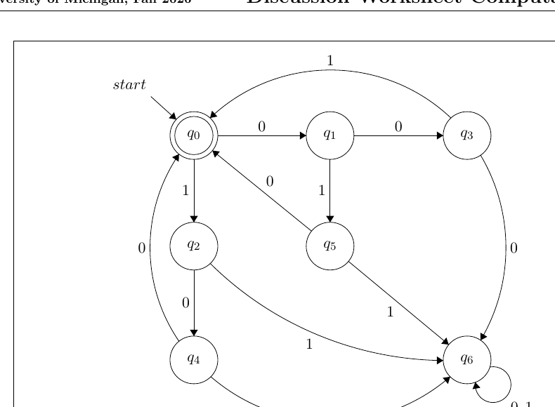
3.2 Problem 8: solution DFA
ADDITIONAL 3.2.8
EECS 376 · Discussion 20 · Computability 1
74

Slide 76
3.2 Problem 8: how to understand the states
ADDITIONAL 3.2.8
1
Block boundary
The start state is accepting: it means we have completed zero or more valid 3-symbol blocks.
2
Within a block
Intermediate states remember the position (1 or 2 symbols read) and how many 0s have appeared so far.
3
Third symbol
If the completed block has exactly two 0s, return to the boundary state; otherwise enter a dead state.
4
Why length matters
Only the boundary state accepts, so the total length must be a multiple of 3.
EECS 376 · Discussion 20 · Computability 1
75

Slide 77
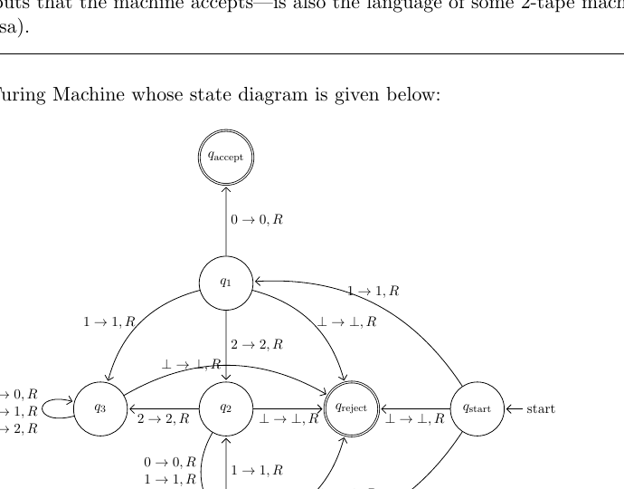
Moved Problem 2.3.5: analyze this Turing machine
ADDITIONAL 2.3.5
Which statement is true?
(a) Accepts all strings containing substring “10”.
(b) Accepts all strings starting with “10”.
(c) Loops on every all-2s string.
(d) “10⊥1” is in its language.
EECS 376 · Discussion 20 · Computability 1
76

Slide 78
Moved Problem 2.3.5: trace the first few symbols
ADDITIONAL 2.3.5
THINK
Do not reason from the whole diagram at once.
Trace what happens after the first symbol, then the second. Also remember: ⊥ is a tape symbol, not an input symbol.
EECS 376 · Discussion 20 · Computability 1
77

Slide 79
Moved Problem 2.3.5: solution, choices (a) and (b)
ADDITIONAL 2.3.5
1
(a) is false
Counterexample: 010 contains substring 10, but the machine rejects it.
2
(b) is true
Every input beginning with 10 follows the transitions into q_accept; the remaining characters no longer matter.
EECS 376 · Discussion 20 · Computability 1
78

Slide 80
Moved Problem 2.3.5: solution, choices (c) and (d)
ADDITIONAL 2.3.5
1
(c) is false
On an input containing only 2s, the head eventually reaches a blank symbol and the machine rejects rather than looping.
2
(d) is false
⊥ is not in the input alphabet Σ, so a string containing ⊥ is not a legal input string.
3
Final answer
Only (b) is true.
EECS 376 · Discussion 20 · Computability 1
79

Slide 81
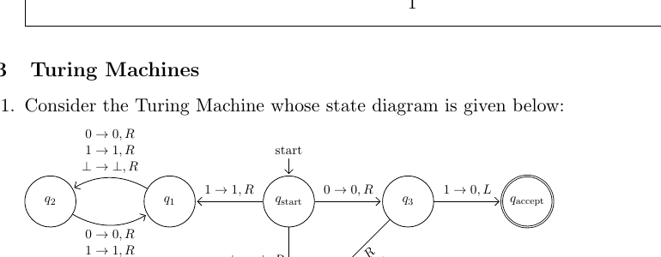
3.3 Problem 1: what language does this TM decide?
ADDITIONAL 3.3.1
Choices
(a) {01} ∪ {s : s starts with 1}
(b) {01}
(c) {s : s starts with 1}
(d) {ε,0,00}
(e) None of the above
Remember: “decides” requires halting on every input.
EECS 376 · Discussion 20 · Computability 1
80

Slide 82
3.3 Problem 1: check halting before identifying a language
ADDITIONAL 3.3.1
THINK
Try an input that starts with 1.
Does the head/state evolution eventually reach q_accept or q_reject, or can it repeat forever?
EECS 376 · Discussion 20 · Computability 1
81

Slide 83
3.3 Problem 1: solution
ADDITIONAL 3.3.1
1
Key behavior
The machine fails to halt on inputs of the form 1(0|1)*.
2
Decider requirement
A TM decides a language only if it halts on every input.
3
Conclusion
This TM does not decide any language. Therefore the correct choice is (e) None of the above.
EECS 376 · Discussion 20 · Computability 1
82

Slide 84
3.3 Problem 2: finitely many written tape cells?
ADDITIONAL 3.3.2
Every / Some / No
_____ Turing machine writes to only finitely many tape cells during its execution.
EECS 376 · Discussion 20 · Computability 1
83

Slide 85
3.3 Problem 2: consider both halting and non-halting machines
ADDITIONAL 3.3.2
THINK
A halting run has only finitely many transitions.
Can a non-halting machine keep moving right forever and write a new cell each step?
EECS 376 · Discussion 20 · Computability 1
84

Slide 86
3.3 Problem 2: solution
ADDITIONAL 3.3.2
1
Answer
SOME.
2
Finitely many example
Any halting computation executes finitely many steps, so it can write to only finitely many cells.
3
Infinitely many example
A machine can loop forever while moving right on blank cells, writing at each step, and therefore touch infinitely many tape cells.
EECS 376 · Discussion 20 · Computability 1
85

Slide 87
3.3 Problem 3: deciders and tape usage
ADDITIONAL 3.3.3
Every / Some / No
_____ Turing machine that decides a language writes to only finitely many tape cells during its execution.
EECS 376 · Discussion 20 · Computability 1
86

Slide 88
3.3 Problem 3: use the halting requirement
ADDITIONAL 3.3.3
THINK
A decider must halt on every input.
What does a finite number of transitions imply about the number of tape cells written?
EECS 376 · Discussion 20 · Computability 1
87

Slide 89
3.3 Problem 3: solution
ADDITIONAL 3.3.3
1
Answer
EVERY.
2
Why
On each input, a decider halts after finitely many steps.
3
Tape consequence
Each transition writes to at most the current tape cell, so finitely many transitions imply only finitely many written cells on that execution.
EECS 376 · Discussion 20 · Computability 1
88

Slide 90
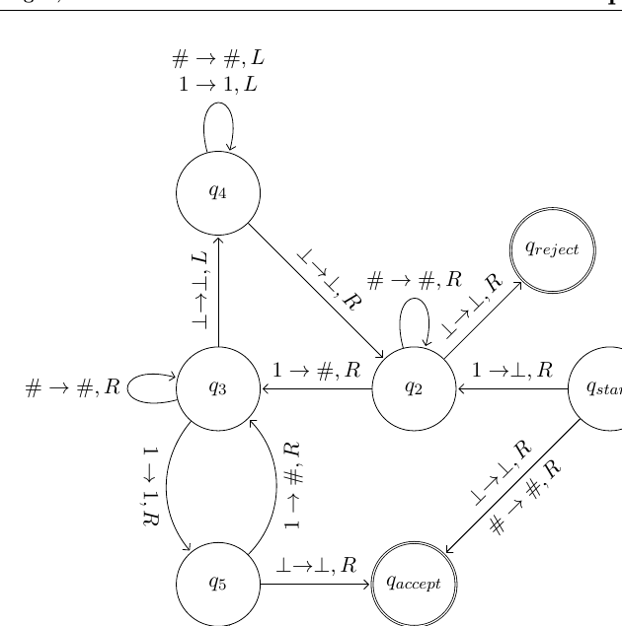
3.3 Problem 4: a unary TM
ADDITIONAL 3.3.4
Question
Input alphabet Σ={1}; tape alphabet Γ={1,#,⊥}.
What language does this machine decide, if any?
Hint from worksheet: What strings does it not accept?
EECS 376 · Discussion 20 · Computability 1
89

Slide 91
3.3 Problem 4: understand one full pass
ADDITIONAL 3.3.4
THINK
On each left-to-right pass, the machine replaces every other remaining 1 by #.
What happens to the number of 1s after each pass?
EECS 376 · Discussion 20 · Computability 1
90

Slide 92
3.3 Problem 4: trace the example |x|=8
ADDITIONAL 3.3.4
1
Start
Input 11111111 (8 ones).
2
Pass 1
Replace every other 1 by #: the tape has 4 remaining 1s.
3
Pass 2
Repeat: 4 remaining 1s become 2.
4
Pass 3
Repeat: 2 remaining 1s become 1.
5
Final behavior
The machine reaches the reject behavior for a power-of-two number of 1s.
EECS 376 · Discussion 20 · Computability 1
91

Slide 93
3.3 Problem 4: generalize
ADDITIONAL 3.3.4
1
Each pass
Halves the number of surviving 1s when that count is even.
2
Odd count > 1
The machine accepts when a pass encounters an odd number of 1s greater than one.
3
Exactly powers of two
Only lengths 1,2,4,8,… stay even on every halving step until one 1 remains, so those are rejected.
4
Language
The machine accepts all unary strings whose length is not 2^n for n ∈ N₀.
EECS 376 · Discussion 20 · Computability 1
92

Slide 94
3.4 Problem 1: add ε to a decidable language
ADDITIONAL 3.4.1
Claim
For any decidable language L, the language L′ = L ∪ {ε} is decidable.
Show the statement is true.
EECS 376 · Discussion 20 · Computability 1
93

Slide 95
3.4 Problem 1: handle ε explicitly
ADDITIONAL 3.4.1
THINK
Let D_L decide L.
Before running D_L, can a new machine first check whether the input is exactly ε?
EECS 376 · Discussion 20 · Computability 1
94

Slide 96
3.4 Problem 1: construct the decider
ADDITIONAL 3.4.1
1
Input x
If x = ε, accept immediately.
2
Otherwise
Run the decider D_L(x). Accept if D_L accepts; otherwise reject.
3
Halting
The extra ε check halts immediately, and D_L halts on all inputs because L is decidable.
4
Correctness
The new machine accepts exactly ε together with all strings in L, i.e. L ∪ {ε}.
EECS 376 · Discussion 20 · Computability 1
95

Slide 97
3.4 Problem 2: set difference
ADDITIONAL 3.4.2
Definition
S \ T = { s ∈ S : s ∉ T }
Question
If S and T are both decidable, S \ T is (always / sometimes / never) decidable.
EECS 376 · Discussion 20 · Computability 1
96

Slide 98
3.4 Problem 2: two deciders, one Boolean condition
ADDITIONAL 3.4.2
THINK
Run D_S(x) and D_T(x).
Which combination of answers means “x ∈ S but x ∉ T”?
EECS 376 · Discussion 20 · Computability 1
97

Slide 99
3.4 Problem 2: solution
ADDITIONAL 3.4.2
1
Answer
ALWAYS.
2
Run both deciders
Because S and T are decidable, D_S and D_T halt on every input.
3
Accept exactly when
D_S(x) accepts AND D_T(x) rejects.
4
Otherwise reject
This accepts exactly S \ T and halts on all inputs, so the set difference is decidable.
EECS 376 · Discussion 20 · Computability 1
98

Slide 100
Placeholder
PLACEHOLDER
Add attendance form / announcements / QR code here
(kept intentionally blank for discussion logistics)
EECS 376 · Discussion 20 · Computability 1
99

